Slide 1
Temporal Representation and Reasoning in Artificial Intelligence

Slide 2
1. Introduction
A Simple Question:
What is “TIME”?
Am I asking a silly question?

Slide 3
The Confessions by Saint Augustine of Hippo
(written between A.D. 397 and A.D. 398)
Who can readily and briefly explain time?
Who can even in thought comprehend time, so as to utter a word about it?
What in discourse do we mention more familiarly and knowingly, than time?
We understand, when we speak of time; we understand also, when we hear it spoken of by another.

Slide 4
What, then is time?
  If no one asks me,
  I know;
  But if I want to explain it to a questioner,
  I don’t know.

Slide 5
Why time?
Time plays an fundamental role in modelling natural phenomena and human activities concerning the dynamic aspects of the real world.
Temporal reference is an idea deeply integrated in human common sense, as well as in the domain of Artificial Intelligence.
Many computer based systems, especially artificial intelligence systems, needs to deal with the temporal dimension of information, the change of information over time and the knowledge about how it changes.

Slide 6
What is Temporal Representation and Reasoning?
It consists of:
formalising the notion of time
providing means of representing and reasoning about the temporal aspects of knowledge/information

Slide 7
Areas requiring TR:
Knowledge Representation and Management
Prediction / Planning
Diagnosis / Explanation
Database Management
Industrial Process Control
Historical Reconstruction
Learning New Physics
Natural Language Understanding
etc.

Slide 8
The Purpose of the Lecure:
explain and motivate interest in an important computer science topic;
provide an overview on some fundamental issues with respects to temporal ontology;
present a brief introduction to the main approaches to the representation of temporal information;
show some illustrating examples such as:
    Temporal knowledge management
    Temporal aspects in e-commerce
    Temporal database systems
    The dividing instant problem

Slide 9
2. The Time Ontology
Temporal Primitive
Theories and Models
Main Approaches to Temporal Representation

Slide 10
2.1. The Temporal Primitive
What sort of objects are going to be taken as the primitive for the ontology of time?
Generally speaking, there are three known choices:
  points, i.e., instants of time with no duration;
  intervals, i.e., periods of time with positive duration;
  both points and intervals

Slide 11
2.2. Theories and Models (1)
Point-based theory
The most traditional structure of time is the standard point-based theory adopted in classical physics.
Usually, a point-based theory consists of a pair (P, ≤), where
  P is a set of points,
  ≤ is an order (partial or total) over P.

Slide 12
2.2. Theories and Models (2)
Point-based theory (cont.)
For particular applications, the characteristics of a point-based system may be specified in great detail, e.g.:
  linear vs. non-linear (including: parallel, circular, etc.)
  dense vs. discrete
  bounded vs. unbounded
Some obvious models:
  the real-numbers time (R, <)
  the rational-numbers time (Q, <)
  and the integer-numbers time (Z, <)

Slide 13
2.2. Theories and Models (3)
Point-based theory (cont.)
In point-based systems, as the derived temporal objects, intervals are usually defined as set, or ordered pairs, of points. E.g.:
Ip = {<p₁, p₂> | p₁ < p₂}
Relations over point-based intervals such as “Equal”, “Before”, “Meets”, “Overlaps”, “Starts”, “During” and “After” (Bru72), as well as the corresponding reverse relations, can be derived from the order relation over time points.

Slide 14
2.2. Theories and Models (4)
Interval-based theory
An interval-based theory posits a pair (I,R) [All83], where
  I is a set of intervals
  R is a set of binary relations over I [All83,84]:
  {Meets, Met_by, Equal, Before, After, Overlaps, Overlapped_by, Starts, Starts_by, During, Contains, Finishes, Finished_by}
The intuitive meaning of Meets(i₁, i₂) is that interval i₁ is one of the immediate predecessors (not necessarily the unique one) of interval i₂.
By formally characterising the Meets relation as primitive, the other 12 binary relations can be derived [AlH89].

Slide 15
2.2. Theories and Models (5)
Interval-based theory (cont.)
Interval-based approach avoids the annoying question of whether or not a given point is part of, or a member of a given interval, which may lead to the so-called Dividing Instant Problem.
However, it is not intuitive/convenient to express instantaneous events, e.g., “The court was adjourned at 4:30pm”, “The light was automatically switched on at 10:00pm”, and so on.

Slide 16
2.2. Theories and Models (6)
Point&Interval-based theory
A point&interval-based theory [MaK94] consists of a triad (T,Meets,Dur), where
  T is a non-empty set of time elements
  Meets is a binary order relation over T
  Dur is a function from T to R₀⁺, the set of non-negative real numbers.
A time element t is called an interval if Dur(t) > 0; otherwise, t is called a point.

Slide 17
2.2. Theories and Models (7)
Point&Interval-based theory (cont.)
In terms of the single primitive relation Meets, other binary relations over points/intervals can be classified into 4 groups:
  Point – Point:
  {Equal, Before, After}
  Point – Interval:
  {Before, After, Meets, Met_by, Starts, During, Finishes}
  Interval – Point:
  {Before, After, Meets, Met_by, Started_by, Contains, Finished_by}
  Interval – Interval:
  {Equal, Before, After, Meets, Met_by, Overlaps, Overlapped_by, Starts, Started_by, During, Contains, Finishes, Finished_by}

Slide 18
2.2. Theories and Models (8)
Point&Interval-based theory (cont.)
Although there are no definitions about the ending-points for intervals, it allows the expression of the "open" and "closed" nature of intervals, which can be formally defined as:
  interval i is left-open at point p iff Meets(p, i)
  interval i is right-open at point p iff Meets(i, p)
  interval i is left-closed at point p
  iff ∃i'(Meets(i', i) ∧ Meets(i', p))
  interval i is right-closed at point p
  iff ∃i'(Meets(i, i') ∧ Meets(p, i'))

Slide 19
3. Temporal Representation
Three main approaches to the representation of temporal information:
  temporal arguments
  modal temporal logics
  reified temporal logics

Slide 20
3.1. The Method of
Temporal Arguments
The so-called method of temporal arguments simply extends functions and predicates of first-order language to include time as the additional argument.
  E.g.: The assertion “Turkey is alive on the 1st of September 1982” can be expressed as: ALIVE(Turkey,01/09/1982)
Main shortcoming:
  Time is represented just as an argument(s) to predicates, no special status to time, neither conceptual nor notational, is accorded; not expressive enough to talk about the generalities of the temporal aspect of assertions. E.g., cannot express common-sense knowledge such as “effects cannot precede their causes”.

Slide 21
3.2. Model Temporal Logics
Modal temporal logics are extensions of the propositional or predicate calculus with modal temporal operators. E.g.:
    Fφ : formula φ “will be true”
    Pφ : formula φ “was true”
    Gφ : formula φ “will be always true”
    Hφ : formula φ “was always true”
MTL is also called Tense Logic in philosophy. The assertion “Turkey is alive on the 1st of September 1982” can be expressed as:
M,01/09/1982╞ ALIVE(Turkey)
where M is the concerned interpretation.

Slide 22
3.3. Reified Temporal Logics (1)
Reified temporal logics “reify” standard propositions of some initial language (e.g., the classical first-order or modal logic) as objects denoting propositional terms. Propositional terms are related to temporal objects or other propositional terms through an additional sort of “meta-predicates”, such as HOLDS (or TRUE), OCCUR and CAUSE, etc.
The assertion “Turkey is alive on the 1st of September 1982” can be expressed as:
HOLDS(01/09/1982, ALIVE(Turkey))

Slide 23
3.3. Reified Temporal Logics (2)
Reified temporal logics are more expressive in:
According the special status to time;
Classifying different types of temporal occurrence;
Representing incompatibility and negation;
Reasoning about event, change and causality;
Representing relationships between events and their effects.

Slide 24
4. Some Application
Examples
4.1 Temporal knowledge management
4.2 Temporal aspects in e-commerce
4.3 Temporal database systems
4.4 The dividing instant problem
4.5 Causal Relationships

Slide 25
4.1.1 Classification of Temporal Information
Absolute temporal references
  E.g., “11 am on the 26th of August 1996” and “the last two weeks of June, 1988”, which refer to times with absolute values;
Relative temporal references
  E.g., “during the time when the Dean was in his office” and “after mid-night”, which refer to times that are known only by their relative temporal relations to other temporal reference, which again, may be absolute or relative;
Absolute temporal durations
  E.g., “45 minutes” and “16 hours”, which refer to some certain amount of temporal granularity;
Relative temporal durations
  E.g., “less than 3 hours” and “more than six years but less than 10 years”, which refer to some uncertain amount of temporal granularity.

Slide 26
4.1.2 A Graphical Representation (1)
Using a partially weighted directed graph to represent temporal knowledge (T, Meets, Dur), where
T is the set of time elements, represented by arcs of the graph;
Meets is the set of immediate predecessor relations, denoted by the node structure, where Meets(t_{i}, t_{j}) is represented by t_{i} being in-arc and t_{j} being out-arc to a common node.
Dur is the set of duration assignments (not necessarily complete): time elements with known duration are weighted by their durations.

Slide 27
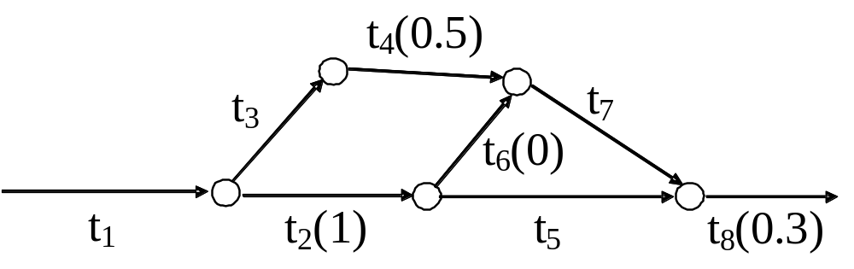
4.1.2 A Graphical Representation (2)
An example:
T = {t₁, t₂, t₃, t₄, t₅, t₅, t₇, t₈, t₉};
Meets = {Meets(t₁, t₂), Meets(t₁, t₃), Meets(t₂, t₅),
Meets(t₂, t₆), Meets(t₃, t₄), Meets(t₄, t₇),
Meets(t₅, t₈), Meets(t₆, t₇), Meets(t₇, t₈)}
Durh = {Dur(t₂) = 1, Dur(t₄) = 0.5, Dur(t₆) = 0, Dur(t₈) = 0.3}

Slide 28
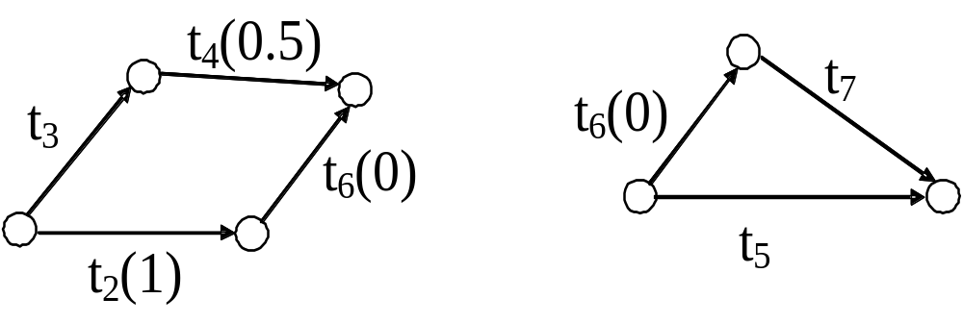
4.1.3 Temporal Knowledge Management
Temporal consistency checking:
There are two simple circuits:
To ensure the temporal knowledge itself is consistent, the directed sum of weights in each of these simple circles has to be 0 [KnM92]. This imposes the following two linear constraints:
  Dur(t2) + Dur(t6) = Dur(t3) + Dur(t4)
  Dur(t5) = Dur(t6) + Dur(t7)

Slide 29
4.1.4 Case Study 1 (1)
Two persons, Peter and Jack, are suspected of committing a murder during the daytime. In court, Jack and Peter gave the following statements, respectively:
Peter’s statements:
  I got home with Jack before 1pm. We had our lunch, and when Jack left I put on a video. The video lasts 2 hours. Before it finished, Robert arrived. When the video finished we went to the train station and waited until Jack came at 4 pm.
Jack’s statements:
  Peter and me went to his home and arrived there before 1pm. When we finished our lunch there, Peter put on a video, and I left and went to the supermarket. I stayed there for between 1 and 2 hours. Then I drove to my home to collect some mail. It takes between 1.5 to 2 hours to reach my home, and about the same to the train station. I arrived at the train station at 4 pm.

Slide 30
4.1.4 Case Study 1 (2)
In addition, being a witness, Robert made this statements:
  I left home at 2 pm and went to Peter’s house. He was playing a video, and we waited till it finished. Then we went together to the train station and waited for Jack. Jack got to the train station at 4pm.
We can use the following temporal references for the corresponding statements in the above scenario:

Slide 31
4.1.4 Case Study 1 (3)
i₁: the time (interval) over which Peter and Jack went to Peter’s home;
1pm: the reference time (point) before which they arrived at Peter’s home;
i₂: the time (interval) over which Peter and Jack had lunch;
i₃: the time (interval) over which Peter played the video (Dur(i₂) = 2);
i₄: the time (interval) over which Jack went to the supermarket;
p₁: the time (point) when Robert arrived at Peter’s house;
i₅: the time (interval) over which Peter and Robert went to the train station;
i₆: the time (interval) over which Peter and Robert waited for Jack at the train
station;
4pm: the time (point) when Jack arrived at the train station;
i₇: the time (interval) over which Jack stayed in the supermarket (1<Dur(i₇)< 2);
i₈: the time (interval) over which Jack drove to his home (1.5<Dur(i₈)< 2);
i₉: the time (interval) over which Jack collected some post from his home;
i₁₀: the time (interval) over which Jack drove to the train station
(1.5<Dur(i₁₀)<2);
2pm: the time (point) when Robert left home;
i₁₁: the time (interval) over which Robert went to Peter's house;
i₁₂: the time (interval) over which Peter and Robert watched the video together;
i₁₃, ..., i₂₇: some extra relative time elements which are used for expressing the
correspondingly relative duration knowledge, e.g., with i₁₉, i₂₀, i₂₁, i₂₂, and
Dur(i₁₉) = 1.5 and Dur(i₂₁) = 2, we can get 1.5 < Dur(i₈) < 2.

Slide 32
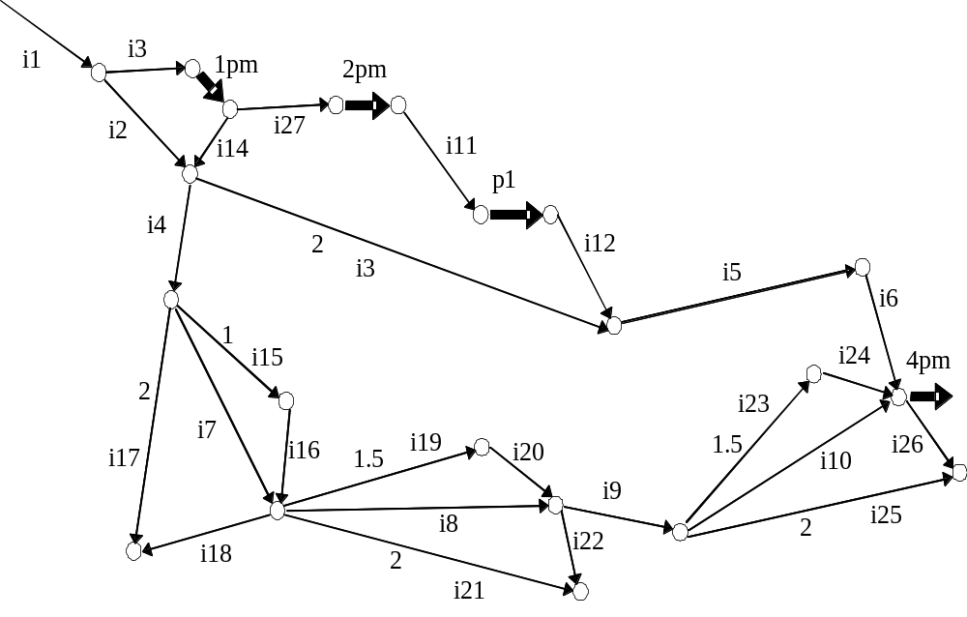
4.1.4 Case Study 1 (4)

Slide 33
4.1.4 Case Study 1 (5)
Consider if the above temporal knowledge is consistent or inconsistent:
Since each interval has a positive duration and each point has a non-negative duration, we can easily see that: Dur(i₅) + Dur(i₆) < 2
In addition, since Dur(i₃) = 2, hence: Dur(i₃) + Dur(i₅) + Dur(i₆) < 2 + 2 = 4
However,
Dur(i₄) + Dur(i₇) + Dur(i₈) + Dur(i₉) + Dur(i₁₀) > 0 + 1 + 1.5 + 0 + 1.5 = 4
Therefore, for the simple circuit i₃, i₅, i₆, i₁₀, i₉, i₈, i₇, i₄, as shown in the following figure, there does not exist any possible duration assignment over the relevant time elements agreeing upon Dur, such that
Dur(i₃) + Dur(i₅) + Dur(i₆) = Dur(i₄) + Dur(i₇) + Dur(i₈) + Dur(i₉) + Dur(i₁₀)
that is,
Dur(i₃) + Dur(i₅) + Dur(i₆) − Dur(i₄) − Dur(i₇) − Dur(i₈) − Dur(i₉) − Dur(i₁₀) = 0

Slide 34
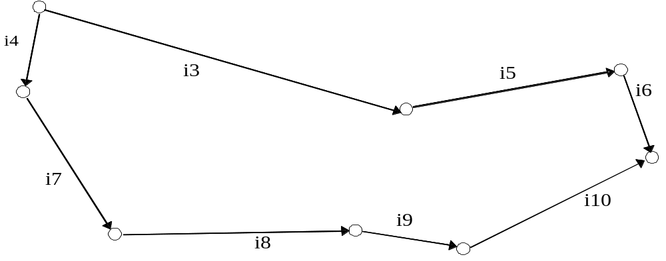
4.1.4 Case Study 1 (6)
Therefore, the temporal knowledge shown in the above is inconsistent, and hence some statements are untrue.
Suppose the video can be checked that it did actually last for two hours, then we can confirm that there must be some falsity in either Robert's or Jack's statements. If it can be proved that Robert did left home at 2 pm, then Jack must have lied when making his statements. Otherwise, to convince that his statements are true, Jack must prove that Robert left home at some time before 2 o’clock in the afternoon.

Slide 35
4.2 Temporal Aspects In E-Commerce (1)
E-business: the application of internet-based technologies for conducting business.
E-commerce: the actual transaction activities in e-business.
First and foremost about business, not technologies.
Technology facilitates e-business.

Slide 36
4.2 Temporal Aspects In E-Commerce (2)
Temporal data play an important role in many e-business/e-commerce systems, e.g.:
  E-banking
  Online-booking (flight, train, hotel, etc.)
  Online-shopping
  Web-based scheduling/planning/budgeting

Slide 37
4.2 Temporal Aspects In E-Commerce (3)
Temporal data is useful for stats and predictions:
  [Blue Martini Software, San Mateo, California, USA]
  User Navigation Behavior
    When do people visit the web-store?
    Which pages do they tend to spend more time on?
  Purchase Patterns
    Who tends to place an online order over a certain time period, e.g., during lunch time, or over the weekends?
    How do seasonal variations affect purchases?
  E-mail Campaigns
    What is the campaign response rate over time?
    Which customers are likely to respond to the campaign within a certain time period?
  Site Behavior
    When is the site busy?
    How does the response rate and conversion rate vary with load?

Slide 38
4.2 Temporal Aspects In E-Commerce (4)
Transforming deictic or incomplete/varying temporal expression to absolute time expressions [HeT03]:
    temporal expression transformation
    now 08.07.2004 11:23
    today 08.07.2004
    in two hours 08.07.2004 13:23
    in five days 13.07.2004
    next Monday 12.07.2004
    at ten to eleven pm 08.07.2004 22:50
    the 12th of April 12.04.2004
    on Christmas Day 25.12.2004

Slide 39
4.2 Temporal Aspects In E-Commerce (5)
An example in on-line flight booking
Book a return ticket from City A to City B, satisfying temporal constraints:
  Date-of-departure is no earlier than a specified date, D^{d}.
  Date-of-return is no later than another specified date, D^{r}.
  The working days between D^{d} and D^{r} (inclusive) are no more than a given number of days, N.
In doing this, time zones/time differences, as well as temporal notions such as “Bank Holiday/Good Friday”, “Christmas Holiday” and “Easter Holiday”, etc., might be involved.

Slide 40
4.2 Temporal Concerns In E-Commerce (6)
A Joke:
What’s the time difference between London and Jinan?
Just a minute.
Thank you.

Slide 41
4.2 Temporal Aspects In E-Commerce (7)
An example in on-line banking
Consider the e-banking workflow, including the activities upon the receipt of an instruction from a customer to transfer £1000 from account A to account B:
Check the balance in account A
If A_balance < 1000, then display message “the transfer cannot be carried out…”
Else, check whether A and B are accounts in the same bank
  If yes, then process the transfer within 1 working day (some special temporal constraint may apply based on the time the instruction is entered)
    Else, process the transfer within three working days.
In both cases, the customer should be able to see/access the updated balance(s) immediately after the processing of the transfer.

Slide 42
4.3 Temporal Database Systems (1)
In conventional database systems, when a database object is updated, its old version will not be retained and hence can not be retrieved.
However, some times, one is not only interested in the representation of a present state, but also in the history of earlier states or a prognosis of future states. For instance:

Slide 43
4.3 Temporal Database Systems (2)
In Medical Information Systems, a patient’s medical record (history) is very important. The doctor needs to know not only the patient’s current status, but also his/her previous health situations, including:
  How long has the patient been ill?
  Did the patient have the same problem or relevant disease previously?
  Has the patient had some treatment already before seeing the doctor?
  Has the patient been allergic to any drugs in the past?

Slide 44
4.3 Temporal Database Systems (3)
Various approaches have been proposed to represent the temporal aspects of data by means of incorporating time into conventional database systems.
Most of them use the relational data model, so as to associate time with database objects, i.e., tuples or attributes.

Slide 45
4.3.1 Valid Time
The valid time of a fact is the time when the fact is true in the modelled reality. Facts are statements that can be true or false.
A fact may associate with any number of time points/intervals.
Valid times are usually supplied by the user.

Slide 46
4.3.2 Transaction Time
The transaction time of a database objects is the time over which the object is (was) taken as part of the current state of the database and may be retrieved.
Transaction times are generally not time points, but time intervals with positive duration. The time, or the "point in time", at which a database object is stored in the database is sometimes called the recording time.
As it is impossible to change the past, (past) transaction times cannot be changed.
Transaction times may be implemented using transaction commit times, and are system-generated/supplied.

Slide 47
4.3.3 Snodgrass and Ahn’ taxonomy
Snapshot databases (i.e., conventional databases)
Historical databases
Rollback databases
Temporal databases (or Bi-Temporal databases)

Slide 48
4.3.3.1 Historical Databases
In a historical database, only valid time is represented
Historical database system supports historical queries about the past, viewing the data valid at some moment as of now
It is not possible to roll back to a previous stage of the database, since whenever a data is updated, the old version of the data will not be retained

Slide 49
4.3.3.2 Rollback Databases
A rollback database addresses transaction time only
Rollback database systems view recorded data, whether valid or not, as of some moment in the time.
Hence, a rollback database system can roll back to a previous stage of the database, but can't make any correction even if there were errors there.

Slide 50
4.3.3.3 Bi-Temporal Database
A (bi-)temporal database addresses both transaction time and valid time
Hence, it can view data valid at some moment seen as of some other moment, completely capturing the history of retroactive/proactive changes.
The user of a temporal database system can examine historical information from the viewpoint of a previous state of the database.
Both transaction time and valid time may be manipulated in a query.

Slide 51
4.3.4 Some Observations
Most temporal database systems require absolute time values for the temporal references.
However, there may be temporal knowledge about a valid/transaction time even though the absolute value is unknown. For example, we may know that event A happened before event B, without knowing the absolute times when they actually started/finished.
Relative temporal knowledge such as this is typically derived from humans: absolute times are rarely remembered, while relative temporal relationships are often remembered.

Slide 52
4.3.5 A Temporal Database Schema
Corresponding to the conventional relation scheme R(A₁, ..., A_{n}), a temporal relation scheme can be defined as:
TR(T_{transaction}, A₁, ..., A_{n}, T_{valid}),
together with a meets table:
Meets(T_{first_argument}, T_{second_argument}),
where instances of T_{transaction}, T_{valid}, T_{first_argument} and T_{second_argument} are all taken from the set of time element, which can be intervals or points.

Slide 53
4.3.6 Case Study 2 (1)
A patient call Lee attending a clinic:
On his first attendance, Lee described that several weeks before, he felt some stomach pain and took a pain-killer (drug a) for some days. However this did no good, and he visited the doctor. A doctor (Dr. Major) cancelled drug a, and prescribed drug b and drug c for three days, asking Lee to come to the clinic after finishing the drugs. Unfortunately, Dr. Major forgot to write down the prescription of drug c on Lee's medical record.
The next time that Lee attended the clinic, he was examined by another doctor (Dr. Long). Since Lee's condition had changed for the better, and his medical record wrongly indicated that the treatment had been just drug b, Dr. Long simply prescribed drug b for another three days.
Thereupon Lee's condition deteriorated. Lee came back to the clinic just after finishing drug b. This time, Dr. Major discovered the mistake, and corrected Lee's medical record. In addition, Dr. Major prescribed drug b and drug c for another seven days.

Slide 54
4.3.6 Case Study 2 (2)
The medical record essentially describes a history of treatments (each with a list of drugs prescribed).
The valid time of each treatment may be characterised as an interval with a positive length. The exact starting-point and finishing-point of each of these periods are not always specified.
However, some temporal facts are known relating to the periods. For example, the period of treatment with drug a comes immediately before treatment with b and c, although its start time and duration are unknown.

Slide 55
4.3.6 Case Study 2 (3)
An interesting aspect of temporal databases illustrated by the example is the importance of the transaction time to inference:
According to the view of the database at the time when Lee was examined by Dr. Long, the database wrongly indicated that Lee's condition changed for the better because of the effect of just drug b, although actually drug b and drug c together were taken.
However, it is not appropriate to delete this wrong information from the database, since if we do so we cannot at a later date tell why doctor Long didn't prescribe drug c at that time.
Instead of over-writing the wrong information, the corrected version must be added to the database, but with its own transaction time.

Slide 56
4.3.6 Case Study 2 (4)
═════════════════════════════════════════════════════
T_{TRANS} PATIENT PRESCRIBER DRUG STATUS T_{VALID}
─────────────────────────────────────────────────────
i_{t1} Lee NULL NULL pain i_{v1}
i_{t1} Lee Lee a worse i_{v2}
i_{t1} Lee Major b NULL i_{v3}
i_{t2} Lee NULL NULL pain i_{v1}
i_{t2} Lee Lee a worse i_{v2}
i_{t2} Lee Major b better i_{v3}
i_{t2} Lee Long b NULL i_{v4}
i_{t3} Lee NULL NULL pain i_{v1}
i_{t3} Lee Lee a worse i_{v2}
i_{t3} Lee Major b&c better i_{v3}
i_{t3} Lee Long b worse i_{v4}
i_{t3} Lee Major b&c NULL i_{v5}
═════════════════════════════════════════════════════

Slide 57
4.3.6 Case Study 2 (5)
There are 5 valid times:
i_{v1} -- the time when Lee first felt pain
i_{v2} -- the time when Lee was treated by means of drug a, administered by himself.
i_{v3} -- the time when Lee was treated by drug b and drug c, prescribed by Dr. Major,
i_{v4} -- the time when Lee was treated by drug b, prescribed by Dr. Long,
i_{v5} -- the time when Lee was again treated by drug b and drug c, prescribed by Dr. Major.
and 3 transaction times:
i_{t1} -- transaction interval following data entry after first appointment with Dr. Major,
i_{t2} -- transaction interval following data entry after first appointment with Dr. Long,
i_{t3} -- transaction interval following data entry after second appointment with Dr. Major.

Slide 58
4.3.6 Case Study 2 (6)
The graphical representation of the corresponding temporal knowledge:
where t₁, t₂ and t₃ represent delays between prescribing and taking the drug. These delays are generally unknown in duration.

Slide 59
4.3.6 Case Study 2 (7)
The record shows three transaction intervals for the validity interval i_{v3}.
The third transaction (interval i_{t3}) corrects the second (interval i_{t2}) which incorrectly records that Lee was taking drug b alone.
However, the reason for Dr. Long's prescription of drug b alone for interval i_{v4} (i.e., that he thought drug b alone had led to improvement over i_{v3}) may still be inferred from the database. This is because the transaction time allows us to retrieve the state of the database at any time in the past.

Slide 60
4.3.6 Case Study 2 (8)
Query: Was it known over i_{t2} that Lee got better using drug b alone?
{x.T_{TRANS}, x.STATUS, x.T_{VALID} ⏐ MEDICAL-RECORD(x) AND
x.PATIENT = "Lee" AND
x.DRUG = b AND
x.T_{TRANS} = i_{t2} }
    Result:
    ═══════════════════════════════════
    T_{TRANS} STATUS T_{VALID}
    ───────────────────────────────────
    i_{t2} better i_{v3}
    i_{t2} null i_{v4}
    ═══════════════════════════════════
The result of this query shows exactly the state of Dr. Long's knowledge according to the transaction time i_{t2}. It shows his belief concerning the past interval, i_{v3}, and his prescription for the coming interval, i_{v4}.

Slide 61
4.4 The Dividing Instant Problem (1)
A fire that has been burning is later burnt out. What exactly happens at the intermediate instant between the two successive states of burning and being extinguished? [van Ben83]
A light that has been off, and becomes on after it is switched on. Is the light off or on at the switching point?[All83]
In general, a proposition holds for a time period and then ceases to hold for a subsequent period. How are we going to decide the truth-value for the proposition at the dividing instant that divides such two successive time periods?

Slide 62
4.4 The Dividing Instant Problem (2)
Four choices:
The proposition is true at the DI, e.g., the light is off at the switching point.
The proposition is false at the DI, e.g., the light is on at the switching point.
The proposition is both true and false at the DI, e.g., the light is both off and on at the switching point.
The proposition is neither true nor false at the DI, e.g., the light is neither off nor on at the switching point.

Slide 63
4.4 The Dividing Instant Problem (3)
On the one hand, it seems that we have no more reason for preferring either 1 or 2, e.g., we have no better reason at all for saying that the light is off at the switching point, than for saying that it is on - the choice must be artificial and arbitrary, and therefore unsatisfactory.
On the other hand, semantically, both 3 and 4 are absurd: the former claim violates the Law of Contradiction and the latter violates the Law of Excluded Third [van Benthem 1983].

Slide 64
4.4 The Dividing Instant Problem (4)
The DI problem is closely related to the question of how to characterise the relationship between time periods and time instants. In point-based temporal systems, it involves the characterisation of the "closed" and "open" nature of time intervals, i.e., whether time intervals include their ending-points or not [All84; Gal90; MaK94]. Assume that
Holds(LightOff, I) and Holds(LightOn, J)
I = <p’, p>, J = <p, p’’>
We have one of the following four choices:
    I is closed at P, and J is open at P.
    I is open at P, and J is closed at P.
    Both I and J are closed at P.
    Both I and J are open at P.
This leads to choices 1-4 choices on slide 62, respectively.

Slide 65
4.4 The Dividing Instant Problem (5)
There are actually 4 possible cases as for point P to be the dividing instant that divides two successive non-compatible states, which holds over interval I and J respectively:
Case 1)
Holds(F, I), Holds(not(F), J), Meets(I, J)
Case 2)
Holds(F, I), Holds(not(F)), J), Holds(not(F), P), Meets(I, J), Meets(I, P)
Case 3)
Holds(F, I), Holds(not(F), J), Holds(F, P), Meets(I, J), Meets(P, J)
Case 4)
Holds(F, I), Holds(not(F), J), Holds(H, P),
Holds(not(F), P), Holds(not(G), P), Meets(I, P), Meets(P, J)

Slide 66
4.4 The Dividing Instant Problem (6)
Case 1): Holds(F, I), Holds(not(F), J), Meets(I, J)
In fact, there are two versions as with respect to further interpretation of Case 1):
C1.1) There is conceptually no dividing instant at all; at most, the dividing instant may be simply taken as the “meeting place” of the two intervals - it is not a real entity at which F or not(F) can hold.
C1.2) The dividing instant does exist and is an entity at which the truth-value of fluent F can be specified. However, in this case, no knowledge (assumption) has been given regarding the truth-value of fluent F at the diving instant (say P) - it is simply unknown. In other words, no assumption is given as to the closed/open nature of interval I and interval J at point P.
I
J

Slide 67
4.4 The Dividing Instant Problem (7)
Case 2): Holds(F, I), Holds(not(F), J), Holds(not(F), P), Meets(I, J)
That is, by some reason for specified applications, the assumption regarding the Dividing Instant P imposed is that fluent F holds false at point P. In other words, interval I is right-open at point P while interval J is left-closed at point P (and therefore, Meets(I, P)). In other words, while interval I “Meets” interval J, point P is “Met_by” interval I and “Starts” interval J.
I
J
P

Slide 68
4.4 The Dividing Instant Problem (8)
Case 3): Holds(F, I), Holds(not(F), J), Holds(F, P), Meets(I, J)
That is, the assumption regarding the Dividing Instant P imposed is that fluent F holds true at point P. In other words, interval I is assumed to be right-closed at point P; and interval J is assumed to be left-open at point P (and therefore, Meets(P, J)). That is, while interval I “Meets” interval J, point P “Finishes” interval I and “Meets” interval J.
I
J
P

Slide 69
4.4 The Dividing Instant Problem (9)
Case 4): Holds(F, I), Holds(G, J), Holds(H, P),
Holds(not(F), P), Holds(not(G), P), Meets(I, P), Meets(P, J)
Unlike Case 1-3), in Case 4), interval I and J do not really meet each other immediately. There is a gap with duration of zero, i.e., point P, standing between interval I and interval J. In other words, both intervals I and J are open at point P. However, we may still think P as the “dividing instant” that divides the two intervals, which meet each other almost immediately (i.e., the duration of the gap between them is zero).
I
P
J

Slide 70
4.4 The Dividing Instant Problem (10)
A fire was burning, two lights (one green and one red) were both off, and a ball was thrown into the air from the east to the west. At the time when the ball reached its apex, the fire burnt out and the lights were switched on.(*)

Slide 71
4.4 The Dividing Instant Problem (11)
From common sense, we have the facts that:
The state that the fire was burned out followed immediately the state that it was burning;
The state that the green light were on immediately followed the state that it was off;
The state that the red light were on immediately followed the state that it was off;
The state that the ball was at the east of and below its apex was immediately followed by the state that the ball was at its apex, and which, in turn, was immediately followed by the state that the ball was at the west of and below the apex.

Slide 72
4.4 The Dividing Instant Problem (12)
In addition, for the reason of general treatment, i.e., addressing all the cases, Case 1) – Case 4), we artificially impose the following assumptions:
  At the time when the ball was at its apex, the green light was on.
  At the time when the ball was at its apex, the red light was off.
Assumptions a) – f) illustrate all the cases as classified on slide 65. In fact, a) is an example of Case 1), b) and e) together can be seen as an example of Case 2), and c) and f) together is an example of Case 3). Finally, d) is an example of Case 4).

Slide 73
4.4 The Dividing Instant Problem (13)
Using a temporal model based on both intervals and points as primitive,
assumptions (a), (b)&(e), (c)&(f), and (d) can be respectively expressed as:
A) Holds(Burning, I₁), Holds(not(Burning), J₁), Meets(I₁, J₁)
B&E) Holds(not(GreenOn, I₂), Holds(GreenOn, J₂), Holds(GreenOn, P),
Meets(I₂, J₂), Meets(I₂, P)
C&F) Holds(not(RedOn, I₃), Holds(RedOn, J₃), Holds(not(RedOn), P),
Meets(I₃, J₃), Meets(P, J₃)
D) Holds(EastBelow, I₄), Holds(AtApex, P), Holds(WestBelow, J₄),
Meets(I₄, P), Meets(P, J₄)
where Duration(P) = 0, Duration(In) > 0 and Duration(Jn) > 0, n = 1, 2, 3, 4.

Slide 74
4.4 The Dividing Instant Problem (14)
Finally, for the state change of the fire, we were told not only (a) The state that the fire was burned out followed immediately the state that it was burning, but also, namely, a’) It is at the time when the ball reached its apex that the fire changed its state from being burning to being burnt out. This extra piece of knowledge (i.e., a’)) can also be successfully expressed. there are intervals I₁’, J₁’, I₄’ and J₄’, such that:
A’) Equal(I₁’, I₁) ∨ Finishes(I₁’, I₁)
Equal(J₁’, J₁) ∨ Starts(J₁’, J₁)
Equal(I₄’, I₄) ∨ Finishes(I₄’, I₄)
Equal(J₄’, J₄) ∨ Starts(J₂’, J₂)
I₁’ ⊕ J₁’ = I₄’ ⊕ P ⊕ J₄’
Duration(I₁’) = Duration(I₄’)
From I₁’ ⊕ J₁’ = I₄’ ⊕ P ⊕ J₄’, we get Duration(I₁’ ⊕ J₁’) = Duration(I₄’ ⊕ P ⊕ J₄’), and with Duration(P) = 0 and Duration(I₁’) = Duration(I₄’), we can infer that Duration(J₁’) = Duration(J₄’). Therefore, A’) subsumes the knowledge that the “meeting place” of intervals I₁’ and J₁’ is point P. Since the “meeting place” of intervals I₁’ and J₁’ is also the “meeting place” of intervals I₁ and J₁, therefore, the extra piece of knowledge a’) can be subsumed from A’).

Slide 75
4.4 The Dividing Instant Problem (15)
I₁
J₁
I₂
J₂
I₃
J₃
I₄
J₄
P
I₁’
J₁’
I₄’
J₄’

Slide 76
4.5 Causal Relationships (1)
We use Occur(e, t) to denote that event e occurs over time t, and impose the following axiom:
(4.1) Occur(e, t) ⇒
∀t’(In(t’, t) ⇒ ¬Occur(e, t’))

Slide 77
4.5 Causal Relationships (2)
We use formula Changes(t₁, t, t₂, s₁, e, s₂) to denote a causal law, which intuitively states that, under the precondition that state s₁ hold over time t₁, the occurrence of event e over time t will change the world from state s₁ into state s₂, which holds over time t₂. Formally, we impose the following axiom about causality to ensure that if the precondition of a causal law holds and the event happens, then the effect expected to be caused must appear:
(4.2) Changes(t₁, t, t₂, s₁, e, s₂) ∧ Holds(s₁, t₁) ∧ Occur(e, t)
⇒ Holds(s₂, t₂)

Slide 78
4.5 Causal Relationships (3)
In order to characterize temporal relationships between events and their effects, we impose the following temporal constraints:
(4.3) Changes(t₁, t, t₂, s₁, e, s₂)
⇒ Meets(t₁, t) ∧ (Meets(t₁, t₂) ∨ Before(t₁, t₂))
It is important to note this axiom actually specifies the so-called (most) general temporal constraint (GTC), which guarantees the common-sense assertion that “the beginning of the effect cannot precede the beginning of the cause”.

Slide 79
4.5 Causal Relationships (4)
There are in fact 8 possible temporal order relations between times t₁, t and t₂ which satisfy (4.3).

Slide 80
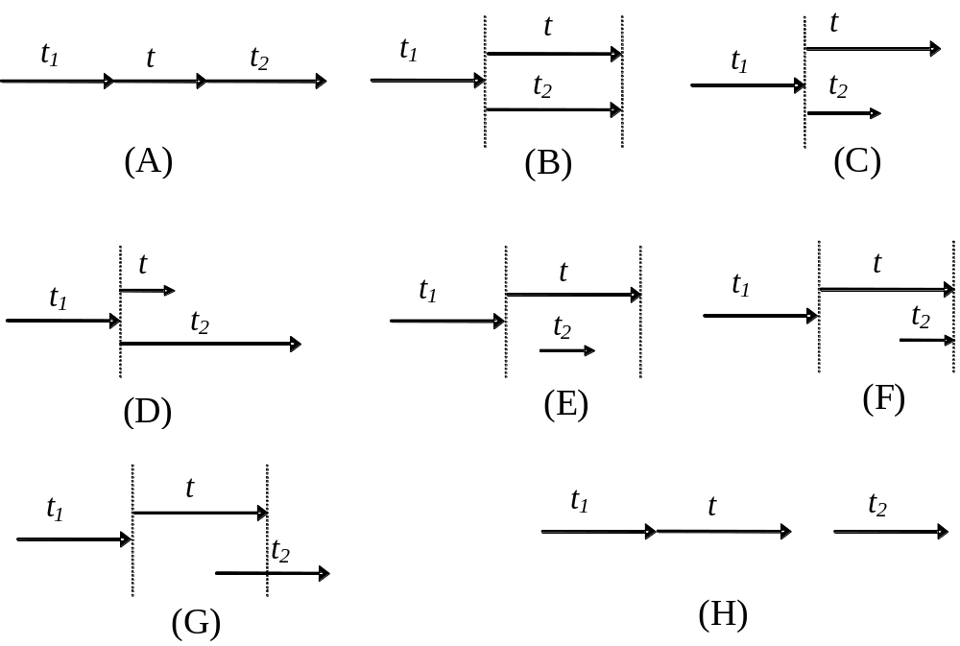
4.5 Causal Relationships (5)

Slide 81
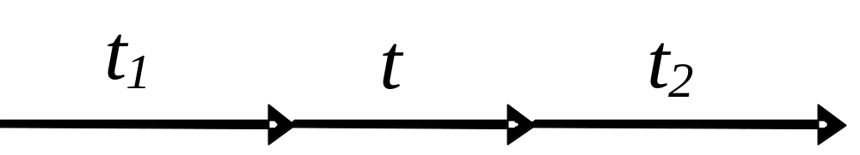
4.5 Causal Relationships (6)
Case (A): the effect becomes true immediately after the end of the event and remains true for some time after the event. E.g., the event of putting a book on the table has the effect that the book is on the table immediately after the event is completed.

Slide 82
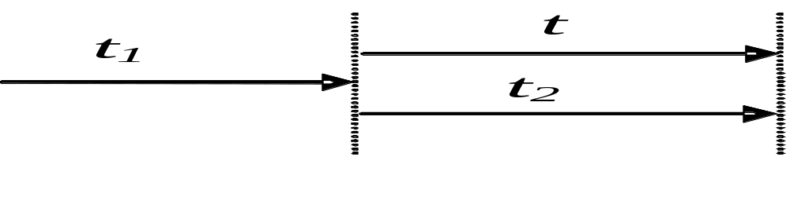
4.5 Causal Relationships (7)
Case (B): the effect holds only over the same time over which the event is in progress. E.g., as the effect of the event of pressing the horn of a car, the horn makes sounds only when the horn is being pressed.

Slide 83
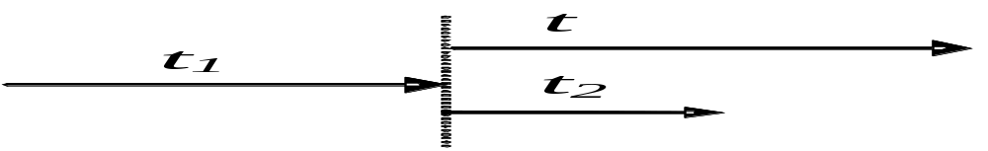
4.5 Causal Relationships (8)
Case (C): the beginning of the effect coincides with the beginning of the event, and the effect ends before the event completes. E.g., consider the case where a landmine is set on the first half of a bridge. If someone is walking through the bridge, he will be in danger just over the first half of the bridge crossing.

Slide 84
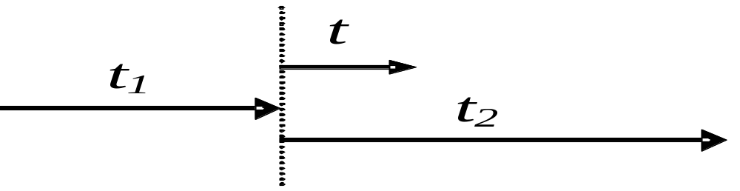
4.5 Causal Relationships (9)
Case (D): the beginning of the effect coincides with the beginning of the event, and the effect remains true for some time after the event. E.g., as the effect of the event of pressing the button of the bell on the door (say, for one second), the bell sounds a tune for fifteen seconds.

Slide 85
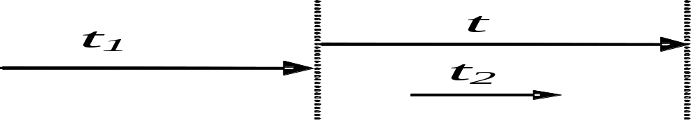
4.5 Causal Relationships (10)
Case (E): the effect only holds over some time during the progress of the event. E.g., he goes through a wall of tiredness over the fiftieth minute of the event of running for four hours.

Slide 86
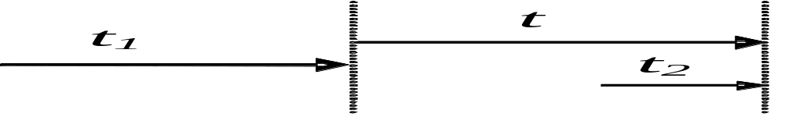
4.5 Causal Relationships (11)
Case (F): the effect becomes true during the progress of the event and remains true until the event completes. E.g., consider the event of discharging some water from a basket by means of lifting one side of the basket. In the case where the basket is not full, the effect that the water flows out takes place only after it has been lifted to the edge of the basket, and will keep flowing out until the event ends.

Slide 87
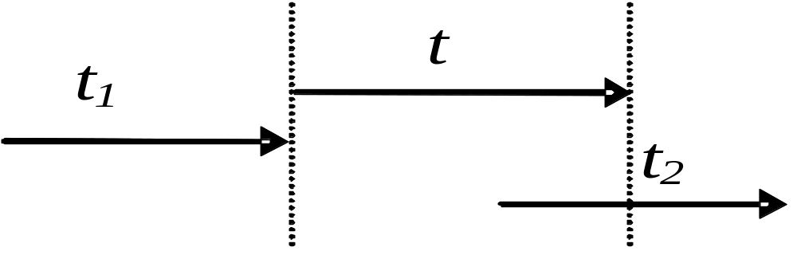
4.5 Causal Relationships (12)
Case (G) where the effect becomes true during the progress of the event and remains true for some time after the event. E.g., he becomes tired for days after the thirtieth minute of the event of running along the track for three hours.

Slide 88
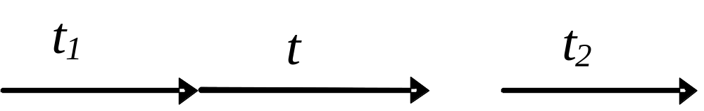
4.5 Causal Relationships (13)
Case (H) where there is a time delay between the event and its effect. E.G., 25 seconds after the button at the crosswalk is pressed, the pedestrian light turns to yellow; and after another 5 seconds, it turns to green.

Slide 89
5. Conclusion
  We have
  shown temporal representation and reasoning plays a vital role in Computer Science.
  overviewed some fundamental issues with respects to temporal ontology.
  presented illustrating case study/examples in Knowledge Management, E-commerce, Database Systems, the DIP and Causal Relationships.

Slide 90
References
Allen, J. “Maintaining Knowledge about Temporal Intervals,” Communication of ACM, (26), 1983, pp.832-843.
Allen, J. and Hayes, P. “Moments and Points in an Interval-based Temporal-based Logic,” Computational Intelligence (5:4), 1989, pp.225-238.
van Benthem, J. The Logic of Time, Kluwer Academic, Dordrech, 1983.
Bruce, B. “A Model for Temporal References and Application in a Question Answering Program,” Artificial Intelligence (3), 1972, pp.1-25.
Heinecke, J., and Toumani, F. “A nature language mediation systems for e-Commerce applications: An ontology based approach,” Workshop on Human Language Technology for the Semantic Web, 2nd ISWC2003, Sanibel Island, Florida, USA.
Knight, B. and Ma A. “A Temporal Database Model Supporting Relative and Absolute Time”, the Computer Journal, (37:7), 1994, pp.588-597.
Knight, B. and Ma, J. “A General Temporal Model Supporting Duration Reasoning”, Artificial Intelligence Communication (5:2), 1992, pp.75-84.
Ma, J. and Hayes, P. “Primitive Intervals Vs Point-Based Intervals: Rivals Or Allies?”, the Computer Journal (49:1, 2006, pp.32-41.
Ma, J. and Knight, K. “A General Temporal Theory,” the Computer Journal (37:2), 1994, pp.114-123.
Ma, J. and Knight, B. “A Reified Temporal Logic,” The Computer Journal (39:9), 1996, pp.800-807.
Ma, J. and Knight, K. “Representing The Dividing Instant,” the Computer Journal (46:2), 2003, pp.213-222.
Shoham, Y. “Temporal Logics in AI: Semantical and Ontological Considerations,” Artificial Intelligence (33), 1987, pp.89-104.

